Slide 1
Advanced Sprint –Part 1 Load Data into the DW

Slide 2
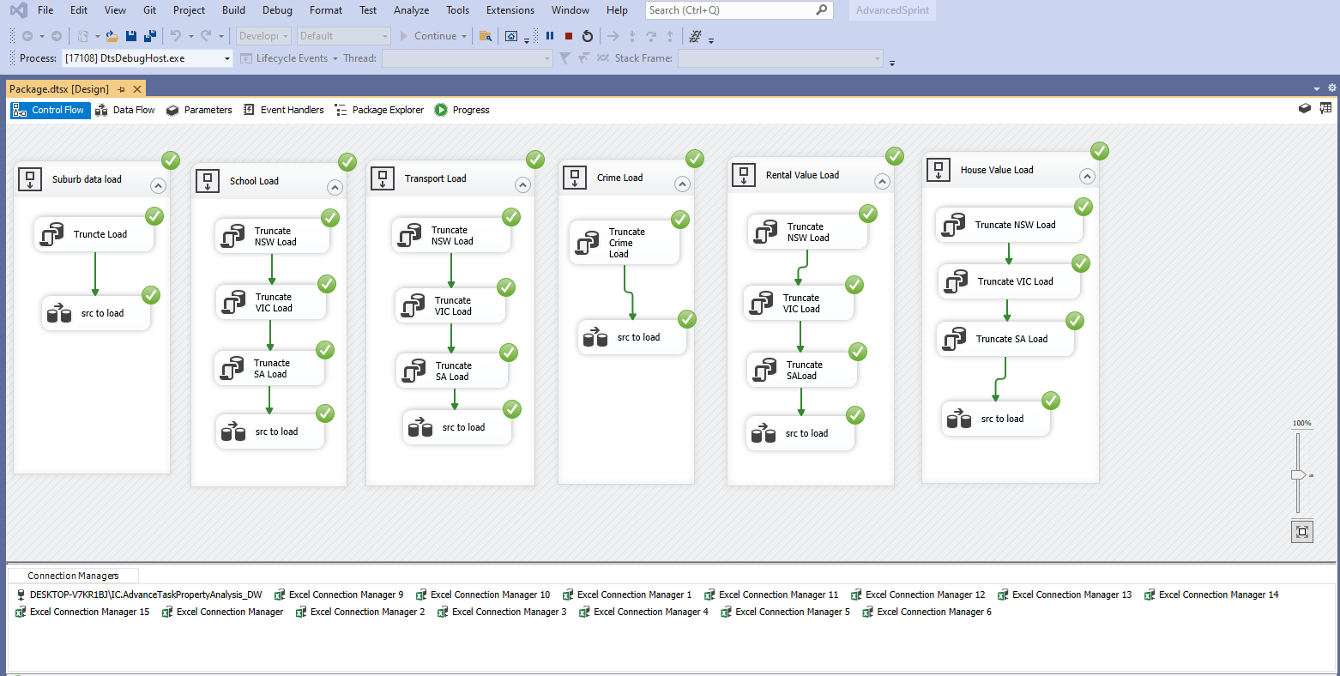
Loading Data from source

Slide 3
